Slide 1


Retail Kart
Domain Oriented Assignment

Slide 2


Index
About the Business
Problem Statement
Data Preparation & Handling
EDA
Dealing with Class Imbalance
Strategies
Conclusion

Slide 3



About The Business
Retailkart.com is a small and medium-scale organization that majorly deals in wine, fruit and meat products, having held around 35% market share. The company has been leading the domain offline for a long time.

Slide 4


Problem Statement
High Cost Per Acquisition for New Customer
Returning Cost Per Acquisition of Customer is also too high

Slide 5
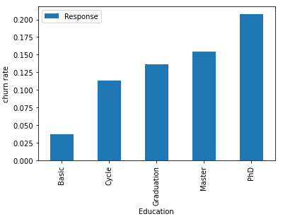
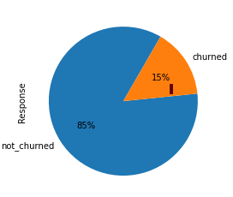
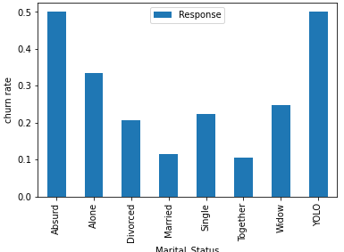
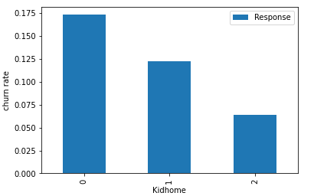
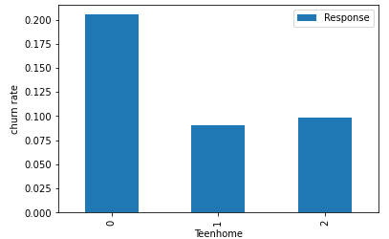
Data Preparation & Handling : Customer Segmentation
85% is Not Churned Data
15% is churn Data
The Campaigns got the response from the following :
PHD from Education
Customer having Yolo & Absurd relationship status
Customer with No Kid

Slide 6
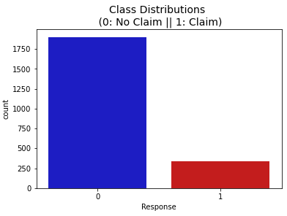
Dealing with Class Imbalance :
SMOTE (Synthetic Minority Oversampling Technique)
Customer Segmentation
Technique used to handle imbalance : SMOTE
Highly Imbalanced.
We can handle imbalanced classes by balancing the classes by increasing minority or decreasing majority
Accuracy = TN+TP / TN+FP+FN+TP Precision = TP / TP+FP Recall = TP / TP+FN F1 Score = 2 x (precision x recall) / (precision + recall) In this problem we will use recall as evaluation metric because we would like to capture the performance where we will be rightly predicting positive classes

Slide 7

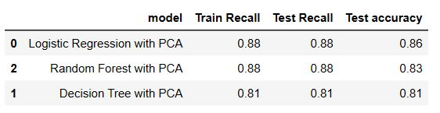

TOP 10 Important Features for PREDICTING CHURN
NumTotalPurchases
MntSnacksProds
NumDealsPurchases
Income
MntMeatProducts
MntFruits
NumStorePurchases
Year_Birth
MntWines
Marital_Status_Single
Final Model is the Random Forest with PCA, as it has the highest Recall value & also the accuracy.

Slide 8
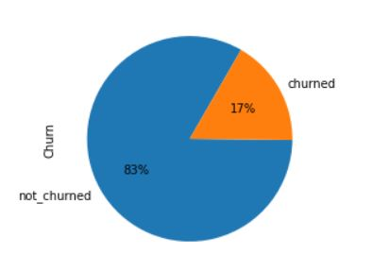
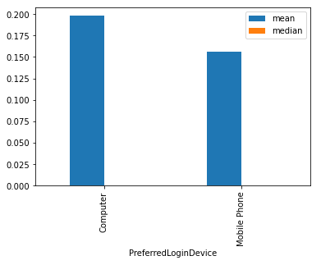
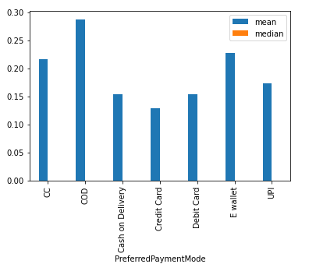
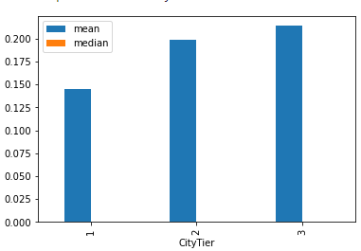
RETAIL APP USER
83% is churn data
Tier 2 & Tier 3 are performing than Tier 1
Both Login device are performing well but computer is bit higher than mobile device.
COD & E-wallet are performing better than other mode of payments.

Slide 9
Dealing with Class Imbalance :
SMOTE (Synthetic Minority Oversampling Technique)
RETAIL APP USER
Technique used to handle imbalance : SMOTE
Highly Imbalanced.
We can handle imbalanced classes by balancing the classes by increasing minority or decreasing majority
Accuracy = TN+TP / TN+FP+FN+TP Precision = TP / TP+FP Recall = TP / TP+FN F1 Score = 2 x (precision x recall) / (precision + recall) In this problem we will use recall as evaluation metric because we would like to capture the performance where we will be rightly predicting positive classes

Slide 10
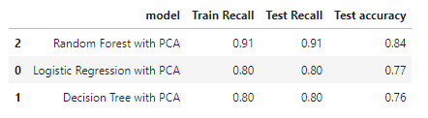

TOP 10 Important Features for PREDICTING CHURN
CouponUsed
NumberOfDeviceRegistered
OrderCount
HourSpendOnApp
DaySinceLastOrder
PreferredPaymentMode_E wallet
NumberOfAddress
PreferredLoginDevice_Mobile Phone
WarehouseToHome
Tenure
Final Model is the Random Forest with PCA, as it has the highest Recall value & also the accuracy.

Slide 11
SUGGESTION
Marketing team needs to promote the business to the following segmentation as per analytics done:
Team need to promote the coupons code to the existing high value customers/buyers
Team needs to focus on Sweet product by offering something extra to customer like an extra buy back, % off, or loyalty point.
Team needs to promote the product with the demographic 30-40 years & 50-60 years as this age group belong to the better Income Level Group & giving better ROI on our Marketing Efforts.
Team needs to focus more on Single (Marital_staus) as they are better performing audience compare to other.
Team need to execute the campaign on all devices as both are performing well
Team needs to give extra discount/Buy Back on Other payment mode to reduce the COD as return of good is loss to our revenue or team should charge extra money for COD user.
Team needs to test the various platforms of digital advertising for better ROI.
Team can optimize Meta, Google Adwords, Bing, etc.

Slide 12
THANK YOU
Riya Chetwani

